Slide 1
By: Dr. Nur Syazana Rashidi
ENGINEERING MATHEMATICS 2
Lecture 1
TOPIC : ORDINARY DIFFERENTIAL EQUATION

Slide 2
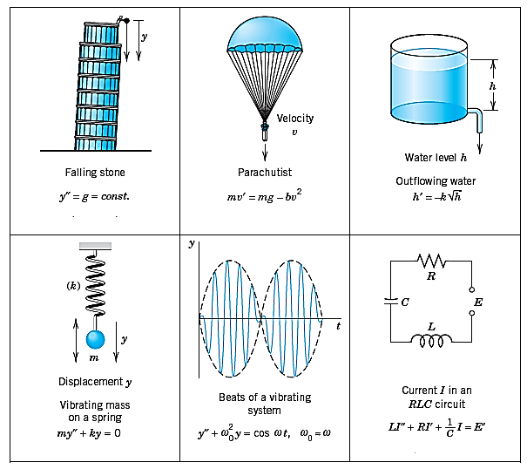
Introduction
If we want to solve an engineering problem (usually of a physical nature), we first have to formulate the problem as a mathematical expression in terms of variables, functions, and equations.
A model is very often an equation containing derivatives of an unknown function.
Such a model is called a differential equation.
Notes:
Sekiranya kita ingin menyelesaikan masalah kejuruteraan (biasanya bersifat fizikal), pertama kita harus merumuskan masalah sebagai ungkapan matematik dari segi pemboleh ubah diberikan dlm soalan, fungsi, dan persamaan. Ungkapan persamaan ini dikenali sebagai model matematik bagi masalah yang diberikan. Proses menyusun model, menyelesaikannya secara matematik, dan menafsirkan hasil dalam istilah fizikal atau lain-lain disebut modelling. Contoh konsep fizikal utk modeling ini adalah, seperti halaju dan pecutan. Oleh itu model selalunya merupakan persamaan yang mengandungi derivative dari fungsi yang tidak diketahui. Model sedemikian disebut persamaan pembezaan.
If we want to solve an engineering problem (usually of a physical nature), we first have to formulate the problem as a mathematical expression in terms of variables,
functions, and equations. Such an expression is known as a mathematical model of the given problem. The process of setting up a model, solving it mathematically, and
interpreting the result in physical or other terms is called mathematical modeling or,
briefly, modeling.
Now many physical concepts, such as velocity and acceleration, are derivatives. Hence a model is very often an equation containing derivatives of an unknown function. Such a model is called a differential equation.

Slide 3





DEFINITION
Differential Equation: An equation which involves differential co-efficient is called a differential equation. The words differential and equation certainly suggest solving some kind of equation that contains derivatives.
Notes:
Kata pembezaan dan persamaan menunjukkan penyelesaian beberapa jenis persamaan yang mengandungi terbitan.
The words differential and equation certainly suggest solving some kind of equation that contains derivatives.

Slide 4
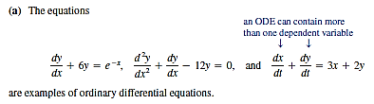
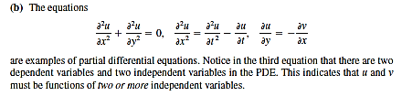
Types of differential equation
ORDINARY DIFFERENTIAL EQUATION
A differential equation involving derivatives with respect to a single independent variable
PARTIAL DIFFERENTIAL EQUATION
A differential equation involving partial derivatives with respect to more than one independent variable
Notes:
(ODE) adalah persamaan yang mengandungi satu atau beberapa derivative fungsi yang tidak diketahui. Persamaan itu mungkin juga mengandungi y itu sendiri, fungsi x (atau t) yang diketahui, dan pemalar.
Persamaan pembezaan separa (PDE), yang melibatkan derivatif separa dari fungsi dua yang tidak diketahui atau lebih banyak pemboleh ubah.
An ordinary differential equation (ODE) is an equation that contains one or several derivatives of an unknown function, which we usually call (or sometimes if the
independent variable is time t). The equation may also contain y itself, known functions of x (or t), and constants.
The term ordinary distinguishes them from partial differential equations (PDEs), which involve partial derivatives of an unknown function of two
or more variables.

Slide 5
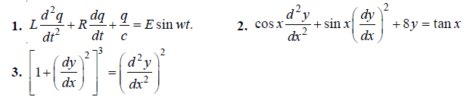
Order and degree of a differential equation
An ODE is said to be of order n if the nth derivative of the unknown function y is the highest derivative of y in the equation
The order of a differential equation is the order of the highest differential co-efficient present equation. Consider
The order of the above equations is 2.
The degree of a differential equation is the degree of the highest derivative after removing the radical sign and fraction.
The degree of the equation (1) and (2) is 1. The degree of equation (3) is 2.
Notes:
The concept of order gives a useful classification into ODEs of first order, second order, and so on.

Slide 6
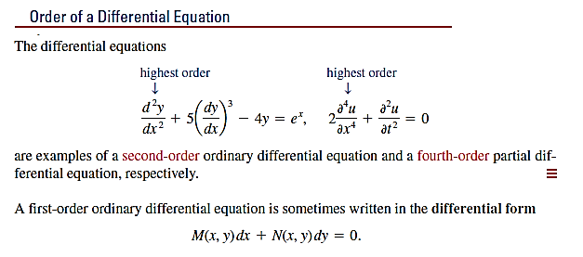

Slide 7
Formation of differential equations
The differential equations can be formed by
(i) differentiating the ordinary equation
(ii) eliminating the arbitrary constants.

Slide 8
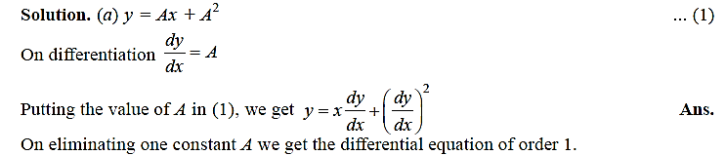
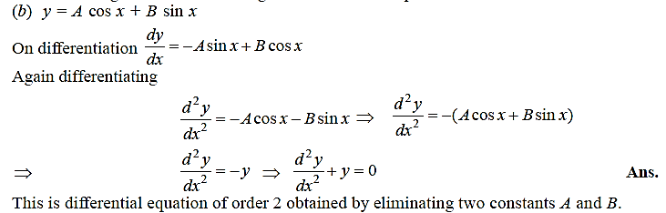
Example formation of differential equations

Slide 9
Initial-value problem

Slide 10
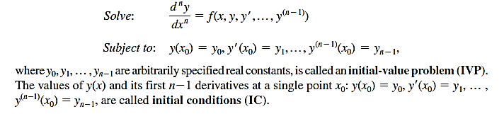
Initial-value problem
Notes:
Dalam kebanyakan kes, penyelesaian unik masalah tertentu, oleh itu penyelesaian tertentu, diperoleh dari penyelesaian umum dengan keadaan awal dengan nilai yang diberikan dan, yang digunakan untuk menentukan nilai pemalar sewenang-wenangnya c. Secara geometri keadaan ini bermaksud bahawa keluk larutan harus melalui titik dalam satah xy. ODE, bersama dengan keadaan awal, disebut masalah nilai awal.
In most cases the unique solution of a given problem, hence a particular solution, is obtained from a general solution by an initial condition with given values
and , that is used to determine a value of the arbitrary constant c. Geometrically this condition means that the solution curve should pass through the point
in the xy-plane. An ODE, together with an initial condition, is called an initial value problem.

Slide 11
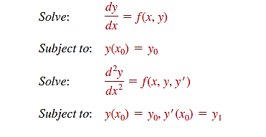
First- and Second-Order IVPs

Slide 12
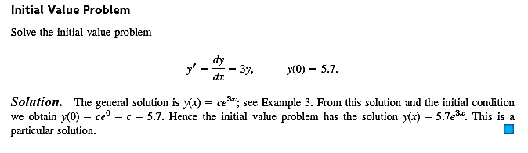
Example : First-Order IVPs
Note: 𝒚=𝒄𝒆𝒙 is the general solution of an ODE 𝒚′=𝒚

Slide 13
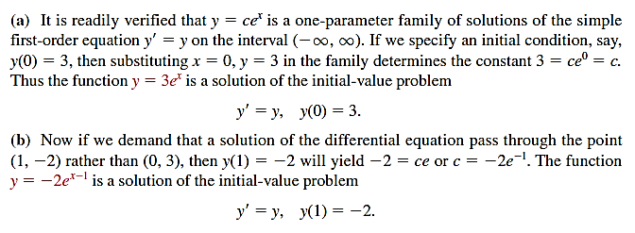
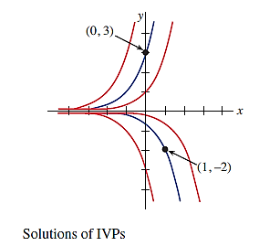
Example : First-Order IVPs
Notes:
Kita sering tertarik dengan masalah di mana kita mencari penyelesaian y (x) dari persamaan pembezaan sehingga y (x) memenuhi syarat sampingan yang ditentukan - iaitu, keadaan yang dikenakan pada y (x) yang tidak diketahui atau pada derivatifnya. Dalam bahagian ini kita meneliti satu masalah yang disebut masalah nilai awal. Istilah keadaan awal berasal dari sistem fizikal di mana pemboleh ubah bebas adalah masa t dan di mana y (t0) y0 dan y (t0) y1 masing-masing mewakili kedudukan dan halaju suatu objek pada awal, atau awal, waktu t0.
We are often interested in problems in which we seek a solution y(x) of a differential equation so that y(x) satisfies prescribed side conditions—that is, conditions that are
imposed on the unknown y(x) or on its derivatives. In this section we examine one such problem called an initial-value problem.
The term initial condition derives from physical systems where the independent variable is time t and where y(t0) y0 and y(t0) y1 represent, respectively, the position and
velocity of an object at some beginning, or initial, time t0.

Slide 14
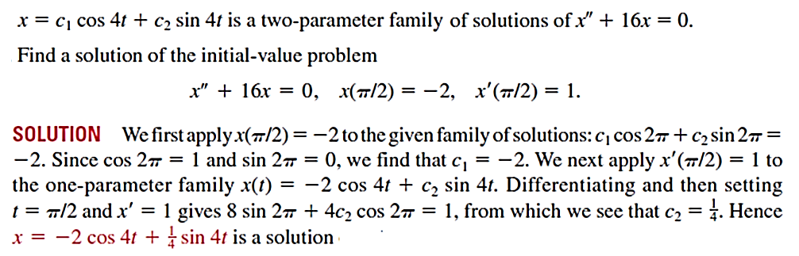
Example : Second-Order IVP

Slide 15
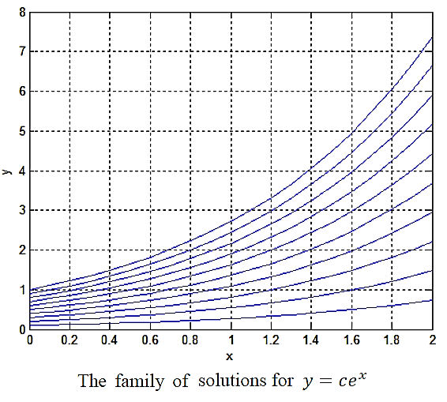
EXAMPLE IVP 1
𝒚=𝒄𝒆𝒙 is the general solution of an ODE 𝒚′=𝒚. Plot the solution curves.
Solution:
The family of solution for different values of 𝑐 (=0.1,0.2,….0.9,1.0) is shown

Slide 16
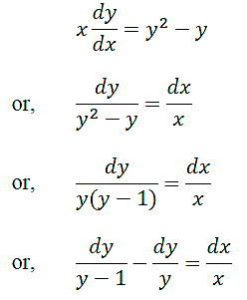
EXAMPLE IVP 2
Determine the general solution of an ODE 𝒙𝒚′+𝒚=𝒚 . Plot the solution curves.
Solution:
Given differential equation can be rearranged as :
2

Slide 17
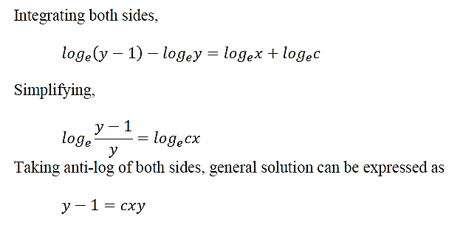

Slide 18
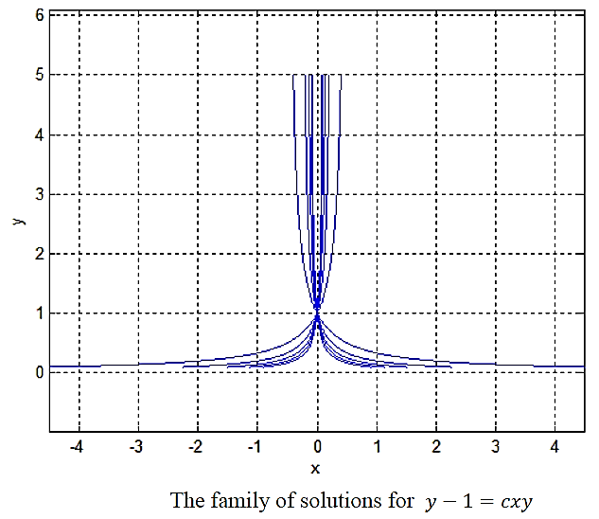

Slide 19
THANK YOU

